Slide 1
7Guard -A small step today for a healthier tomorrow-

Slide 2

introduction
“7Guard” is introduced as an innovative solution to make the child vaccination process easier for the parents, guardians, and healthcare providers. By offering a well-designed, user-friendly digital platform, the system addresses the key points of vaccine registration and management. 7Guard ensures that all the stakeholders are served with quality service, enhancing greater efficiency, accuracy and awareness in child healthcare.

Slide 3
WHY?
Child vaccination is one of the most critical aspects of ensuring health and well-being of children. Yet, the process of managing vaccination appointments and records is outdated and hard work.
Parents, or the guardians of the children often face challenges, such as, time consuming manual scheduling, lack of accessible vaccination histories, and not having accurate records of children’s health.
There may be barriers to communication between parents and healthcare providers as well.

Slide 4
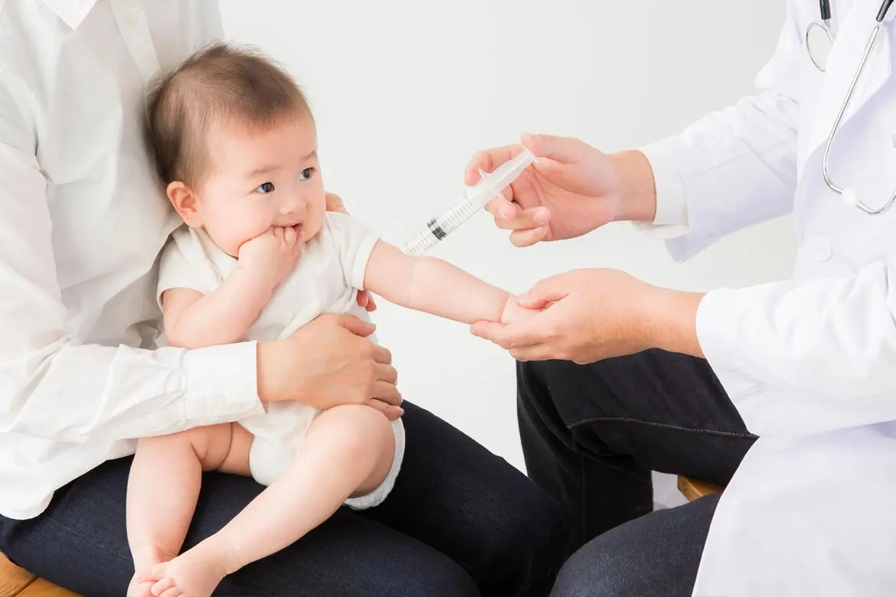
OBJECTIVES OF THE PROJECT
The main objective of 7guard is to streamline the child vaccination process by providing a user-friendly interface that provides easy vaccination appointments, real-time updates and reminders, and an online accessible CHDR card.

Slide 5
STAKEHOLDERS
Parent/ Guardian of children
Doctor
Nurse
Hospital Receptionist
Pharmacist
Administration

Slide 6
Functionalities
User registration
Online vaccination appointments
Assigning doctors for appointments
Online appointment reminders
Issue doctor prescriptions
Store vaccine data through vaccine barcode
Vaccine stock management
BMI calculation and BMI based advices
Medication based on possible side effects
User feedback

Slide 7
UNIQUE FEATURES
Online accessible CHDR card that allows parent/guardian and healthcare providers to access the records related to the vaccinations anytime.
Online vaccination appointments that saves time and extra cost related to making on call appointments or physical appointments.
Digitalized vaccine history of children.

Slide 8
Sustainability of 7guard
Environment Sustainability: Digitalizing vaccine records and the online appointments minimizes paper usage and energy.
Social Sustainability: The vaccination reminders enables timely vaccinations to improve healthcare of the children. The advices provided by the system educate and spread awareness about the vaccinations. Feedback from the users ensure good interactions between the users and system while improving user satisfaction.
Economic Sustainability: Automated process reduce administrative costs for healthcare providers. Streamlined operations reduce errors, save time, and manage resources resulting long-term economic benefits.

Slide 9
SOCIAL IMPACT
Improved child healthcare: Promotes preventive healthcare.
Enhanced Accessibility to healthcare: Simplifies vaccination process.
Empowerment of parents: Increase awareness of child health.
Promotes Equity: Anyone can access the system at anytime.

Slide 10
TARGET MARKET
Parents/guardians who need of an efficient digitalized process for child vaccination management.
Hospitals who need collaboration with a digital platform for child vaccination management.
Category | Cost (LKR)
Software Development | 0
Development Tools | 0
Deployment Fee | 200,000
Product Price | 600,000
Notes:
Even though the target market is all the children of Sri Lanka (All children’s data is saved in the system), the cost of the system differs per hospital. Cost is allocated per hospital.

Slide 11
CHALLENGES
Lack of technical literacy of people: There may be users who are not familiar with technology or lack the necessary devices to receive the services.
Slow or lack of internet connection: Based on the facilities and the area from where the users are from, there might be connection issues to access the system.
Issues of understanding the language: Since English is not the mother language of Sri Lankans, there might be issues of understanding the system for anyone who lacks the language skills.

Slide 12

Conclusion
The purpose of 7guard is to streamline and modernize the child vaccination process by covering the services and meet the project’s objectives by strengthening efficiency, accuracy, accessibility, and interactions between the parent or guardians and the healthcare providers. The system offers benefits to the stakeholders of the system and encourages the users to engage with improved child health care delivery.

Slide 13

Thank you

